Slide 1

Fame!
Making a Name for Yourself in the
World of International Legal Academia
Prof. P. Bernt Hugenholtz
Workshop UiB
Solstrand Hotel
3-4 November 2014
Notes:
1

Slide 2
Some misconceptions about fame in academia
Fame does not matter in science
Fame is bad for your reputation
Fame comes automatically with good PhD and publications

Slide 3
Why do we need fame in academia?
Becoming part of an international academic network
Getting invited to workshops, conferences, collaborative projects (and boards, committees etc.)
Having an influence in society
Getting a job (promotion) in academia
Getting invited as a visiting researcher/scholar
Getting your work internationally published
Because it’s cool to be famous

Slide 4
Making your name at an international conference
Conferences are not (just/primarily) for learning things
Prepare a few questions for Q&A
  And make sure that you pose one!
Talk to interesting people (and google them)
Move around at social events
Bring business cards and articles (or drafts)

Slide 5
Making your name in the press
Write an OpEd for a newspaper
  It’s easier to get a piecesaccepted than you think!
Make a press release if you think your research may have news value
Build relationships with journalists

Slide 6
Making your name online
SSRN

Slide 7
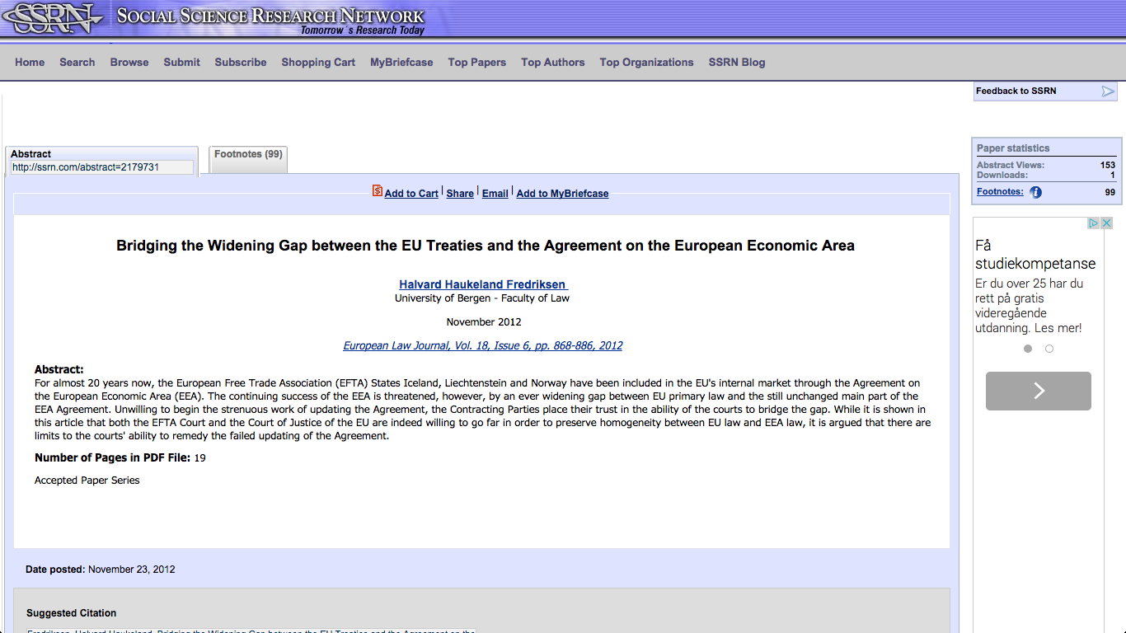

Slide 8
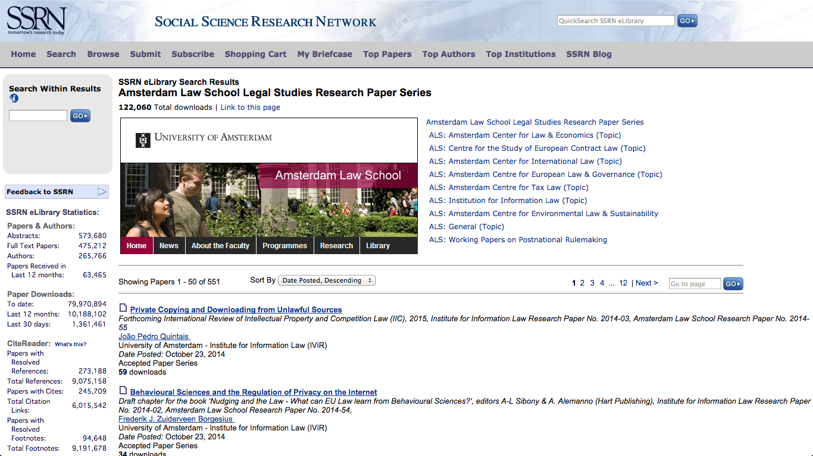

Slide 9
Making your name online
SSRN
Institute or university web site

Slide 10
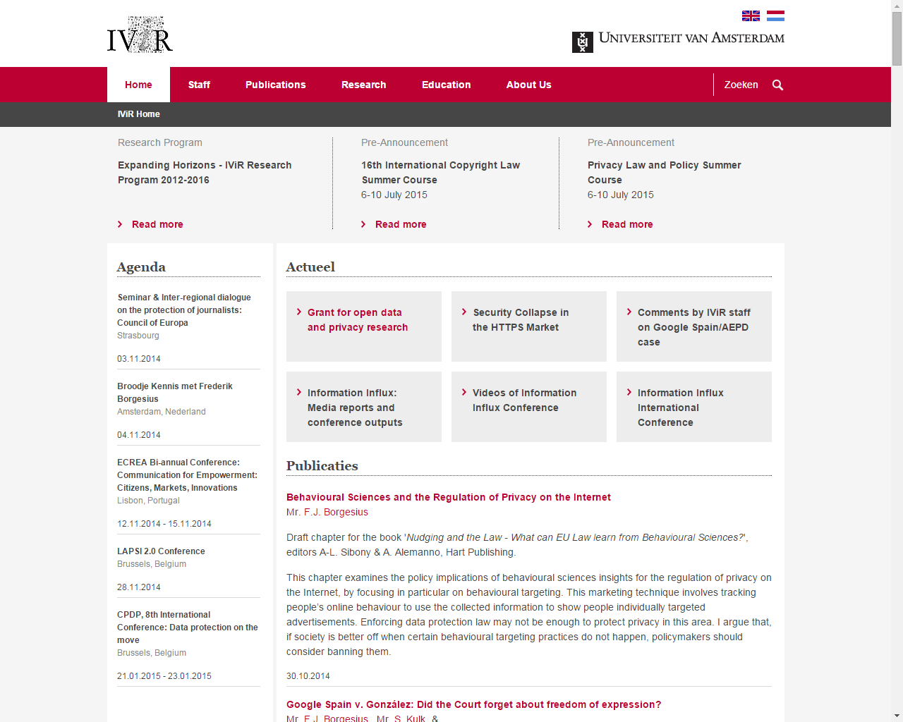

Slide 11
Making your name online
SSRN
Institute or university web site
Specialized blogs

Slide 12
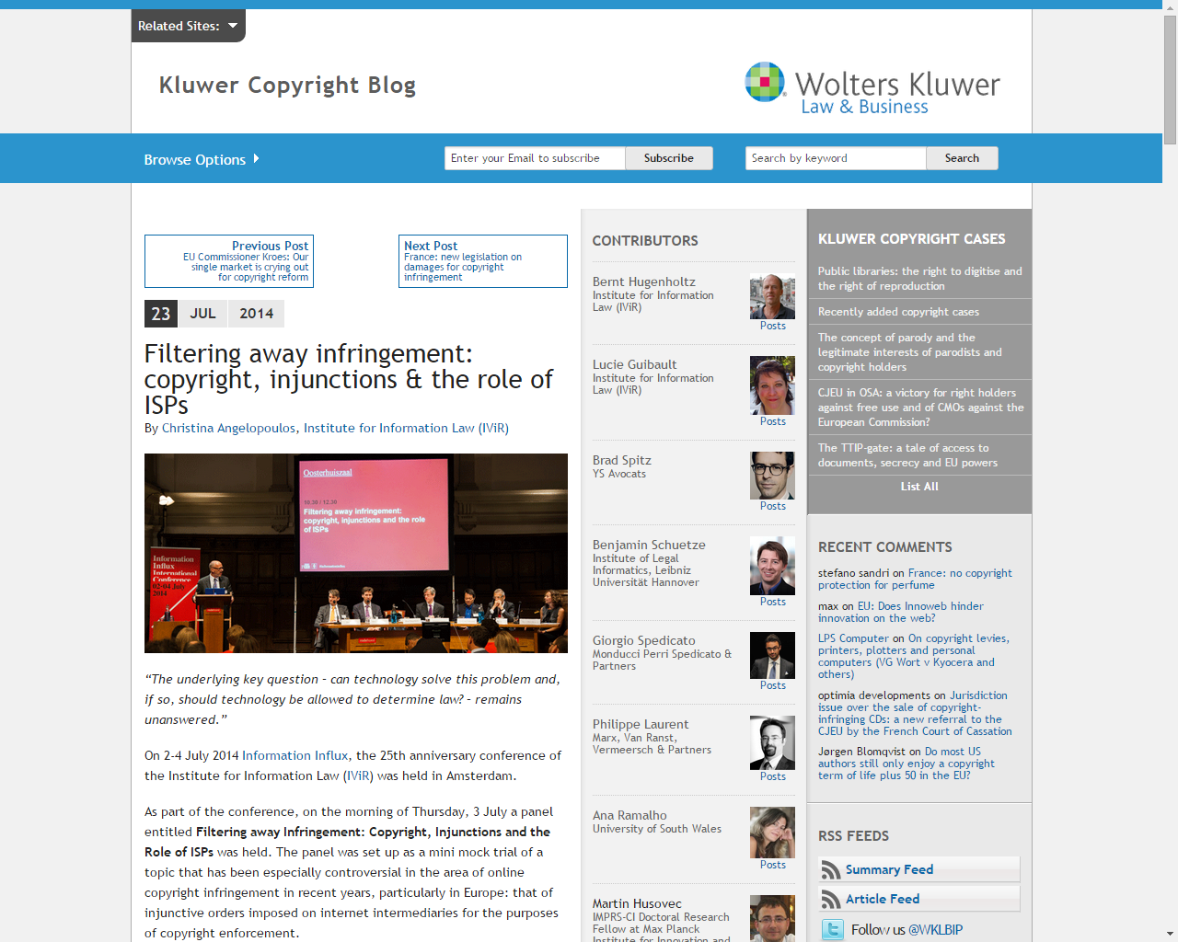

Slide 13
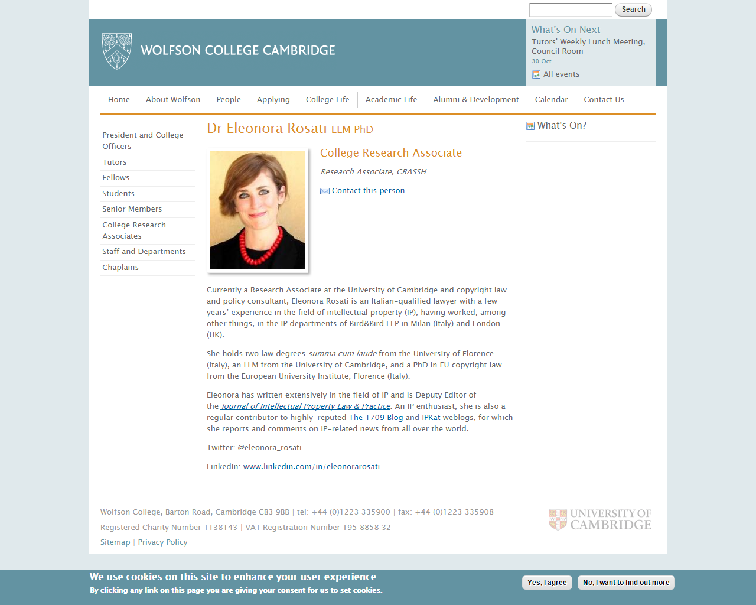

Slide 14
Making your name online
SSRN
Institute or university web site
Specialized blogs
How about starting your own blog?

Slide 15
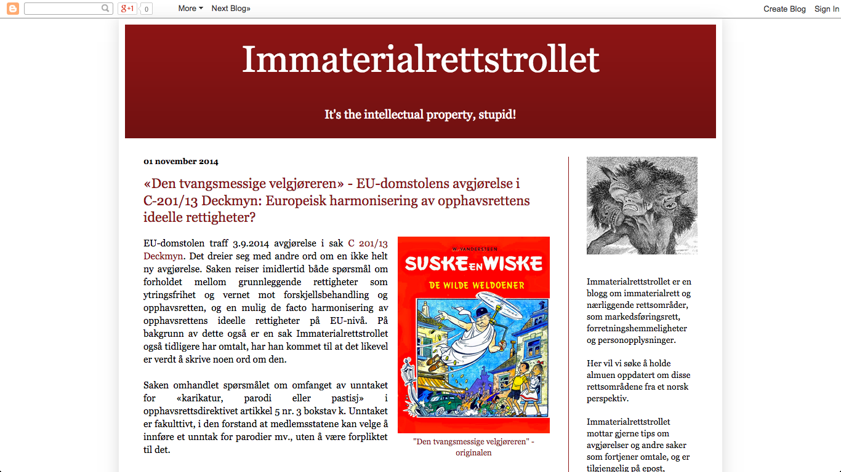

Slide 16
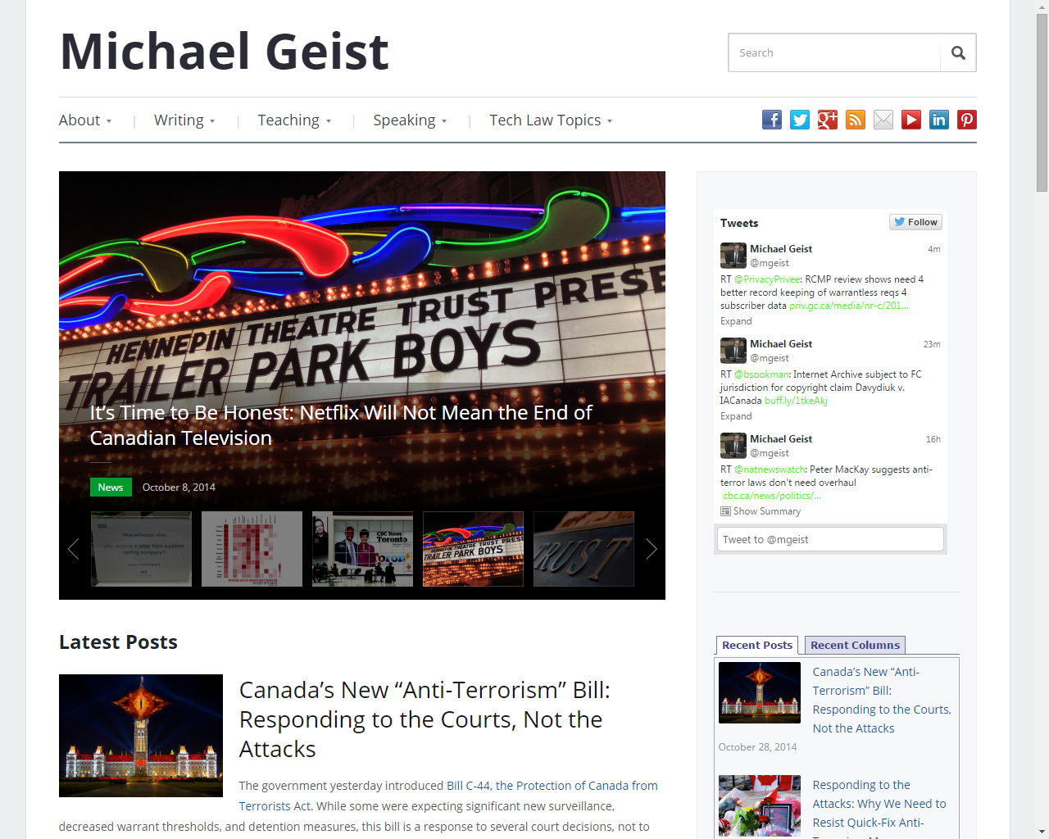

Slide 17
Making your name online
SSRN
Institute or university web site
Specialized blogs
How about starting your own blog
Social media: LinkedIn, Twitter (?)

Slide 18
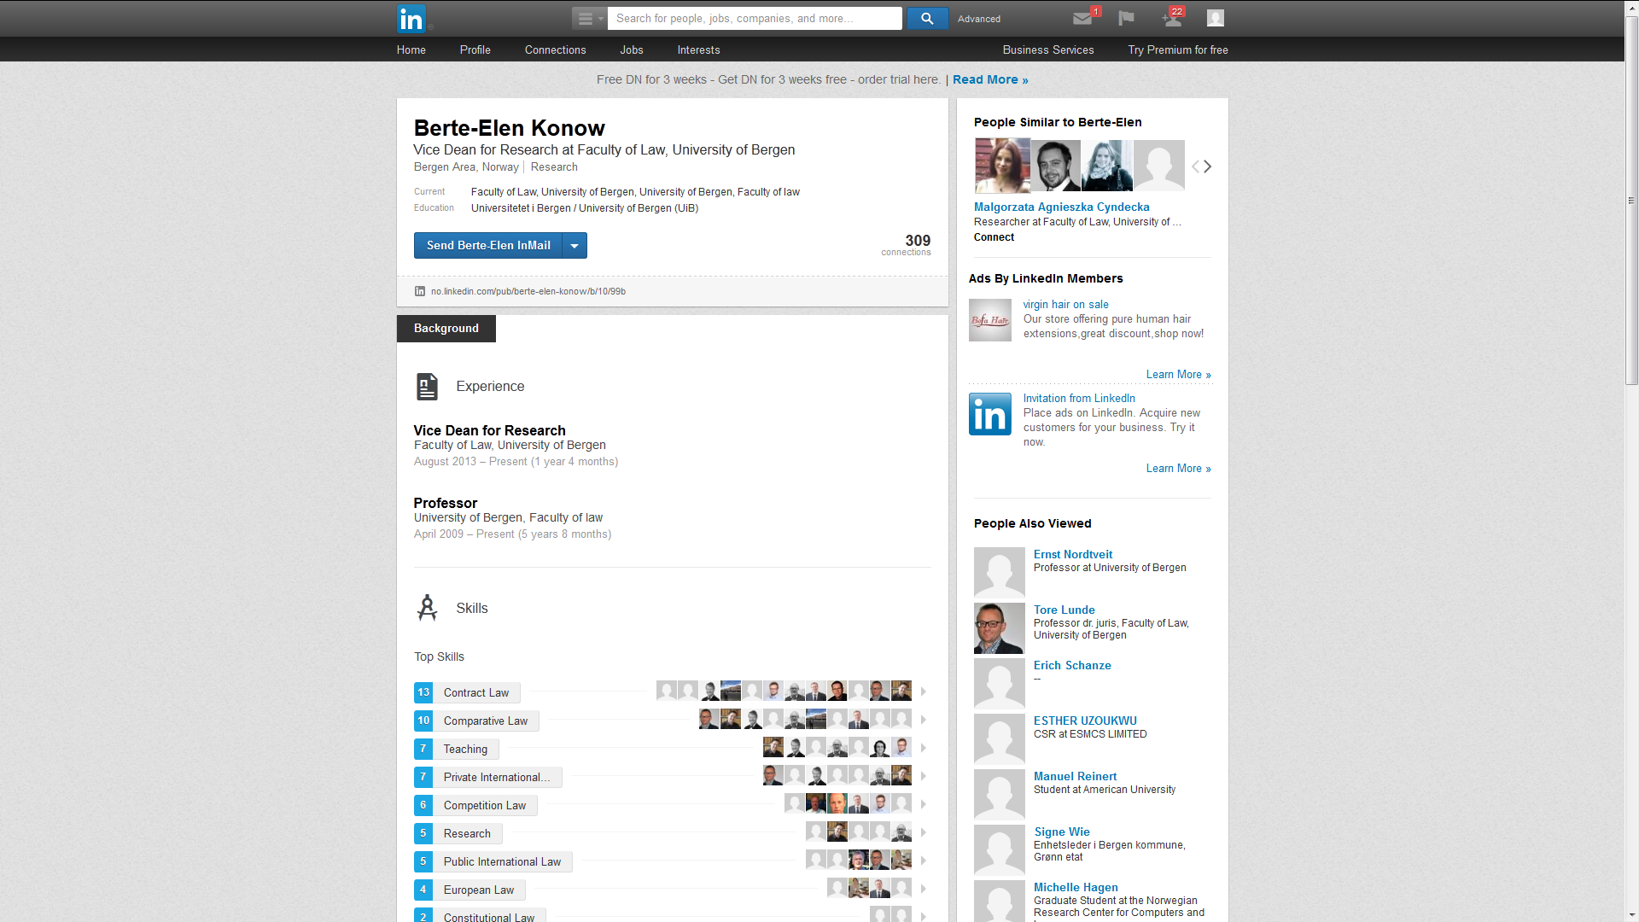

Slide 19
Making your name online
SSRN
Institute or university web site
Specialized blogs
How about starting your own blog
Social media: LinkedIn, Twitter (?)
> You and your work should be ‘googlable’!

Slide 20
Other ways of building an international reputation
Organize international symposia, workshops!
  The speakers you invite, may reciprocate
Give talks abroad!
  Volunteer, don’t wait for an invite
  Respond to calls for papers
Visit institutes or research centres abroad!
Win a foreign grant or prize!

